Slide 1
Chapter 9
Data Design

Slide 2
Learning Objectives (1 of 2)
After this chapter, you will be able to:
Explain basic data design concepts, including data structures, DBMSs, and the evolution of the relational database model
Explain the main components of a DBMS
Define the major characteristics of web-based design
Define data design terminology
Draw entity-relationship diagrams
Apply data normalization

Slide 3
Learning Objectives (2 of 2)
Utilize codes to simplify output, input, and data formats
Explain data storage tools and techniques, including logical versus physical storage
Explain data coding
Explain data control measures

Slide 4
Data Design Concepts (1 of 5)
Data structures
Framework for organizing, storing, and managing data
Comprises of files or tables that interact in various ways
Each file or table contains data about people, places, things, or events

Slide 5
Data Design Concepts (2 of 5)
Mario and Danica: A Data Design Example
Mario’s auto shop uses file-oriented systems
MECHANIC SYSTEM uses the MECHANIC file to store data about shop employees
JOB SYSTEM uses the JOB file to store data about work performed at the shop
Danica’s auto shop uses a relational model
SHOP OPERATIONS SYSTEM: tables are linked by a common field named Mechanic No field

Slide 6
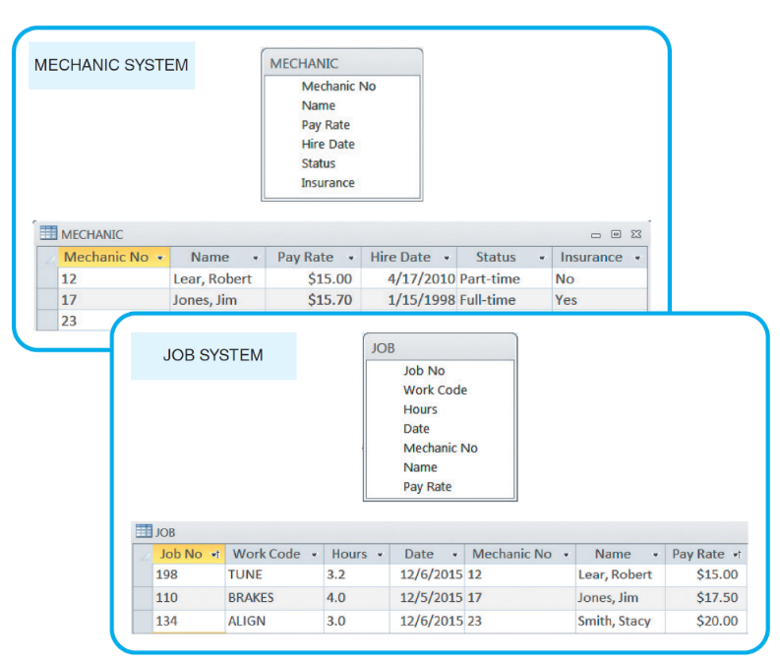
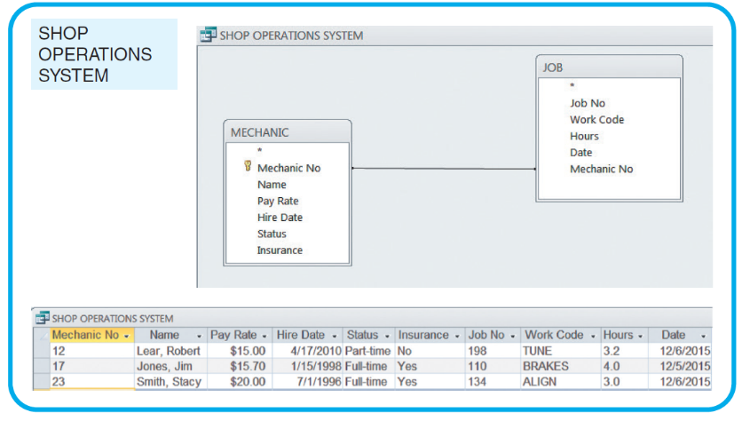
Data Design Concepts (3 of 5)
FIGURE 9-4 Danica’s SHOP OPERATIONS SYSTEM uses a database design, which avoids duplication. The data can be viewed as if it were one large table, regardless of where the data is stored physically.
FIGURE 9-3 Mario’s shop uses two separate systems, so certain data must be entered twice. This redundancy is inefficient and can produce data errors.

Slide 7
Data Design Concepts (4 of 5)
Database management system (DBMS)
Collection of tools, features, and interfaces that enables users to add, update, manage, access, and analyze data
Advantages
Scalability
Economy of scale
Enterprise-wide application
Stronger standards and better security
Data independence

Slide 8
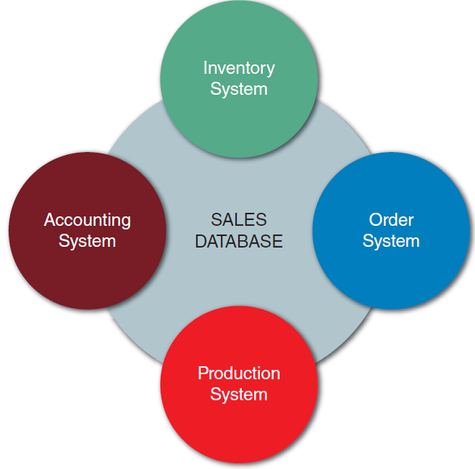
Data Design Concepts (5 of 5)
Figure 9-5 In this example, a sales database can support four separate business systems.

Slide 9
DBMS Components (1 of 2)
Interfaces for users, database administrators, and related systems
Users
Work with predefined queries and switchboard commands
Database administrators
Responsible for DBMS management and support
Related information systems
DBMS provides support to related information systems

Slide 10
DBMS Components (2 of 2)
Schema
Descriptions of all fields, tables, and relationships
Subschema: database portions that a particular system or user needs or is allowed to access
Physical data repository
Contains the schema and subschemas
Can be centralized or distributed
Uses open database connectivity (ODBC) compliant software

Slide 11
Web-Based Design (1 of 2)
Databases are created and managed by using languages and commands that have nothing to do with HTML
Objective: connect the database to the Web and enable data to be viewed and updated
Middleware is used integrate different applications and allow them to exchange data
Web-based data must be secure, yet easily accessible to authorized users

Slide 12
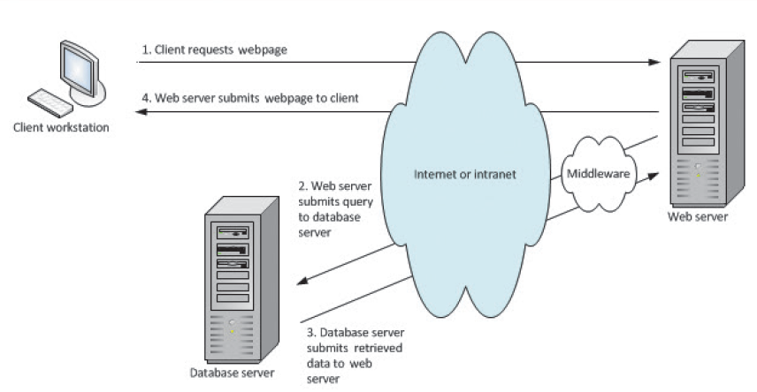
Web-Based Design (2 of 2)
FIGURE 9-9 When a client workstation requests a Web page (1), the Web server uses middleware to generate a data query to the database server (2). The database server responds (3), and middleware translates the retrieved data into an HTML page that can be sent by the Web server and displayed by the user’s browser (4).

Slide 13
Data Design Terms (1 of 3)
Definitions
Entity: person, place, thing, or event for which data is collected and maintained
Table or file: contains a set of related records that store data about a specific entity
Field (i.e., attribute): single characteristic or fact about an entity
Common field: attribute in more than one entity
Record (i.e., tuple): set of related fields that describes one instance of an entity

Slide 14
Data Design Terms (2 of 3)
Key fields
Primary key: field or fields that uniquely and minimally identifies a member of an entity
Candidate key: field that could serve as a primary key
Foreign key: field in one table that must match a primary key value in another table for a relationship between the two tables to exist
Secondary key: field or combination of fields that can be used to access or retrieve records

Slide 15
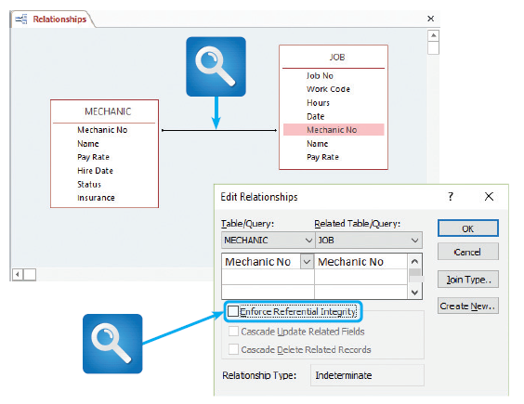
Data Design Terms (3 of 3)
Referential integrity
Set of rules that avoids data inconsistency and quality problems
FIGURE 9-11 Microsoft Access allows a user to specify that referential integrity rules will be enforced in a relational database design.

Slide 16
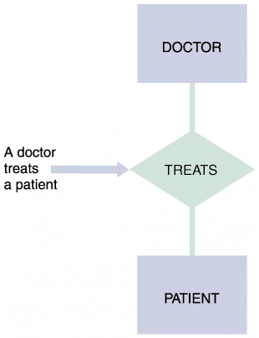
Entity-Relationship Diagrams (1 of 8)
Drawing an ERD
List the entities that were identified during the systems analysis phase
Consider the nature of the relationships that link them
FIGURE 9-12 In an entity-relationship diagram, entities are labeled with singular nouns and relationships are labeled with verbs. The relationship is interpreted as a simple English sentence.

Slide 17
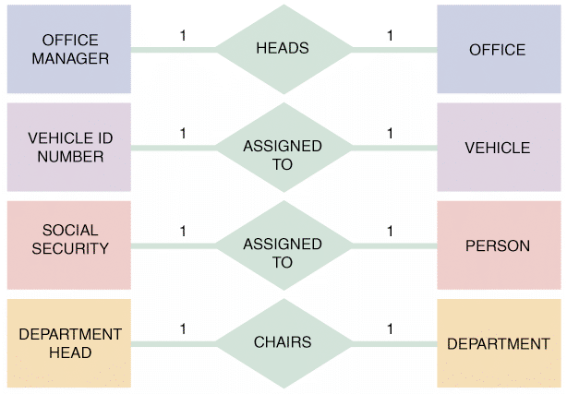
Entity-Relationship Diagrams (2 of 8)
Types of relationships
One-to-one (1:1) relationship: exactly one of the second entity occurs for each instance of the first entity
FIGURE 9-13 Examples of one-to-one (1:1) relationships.

Slide 18
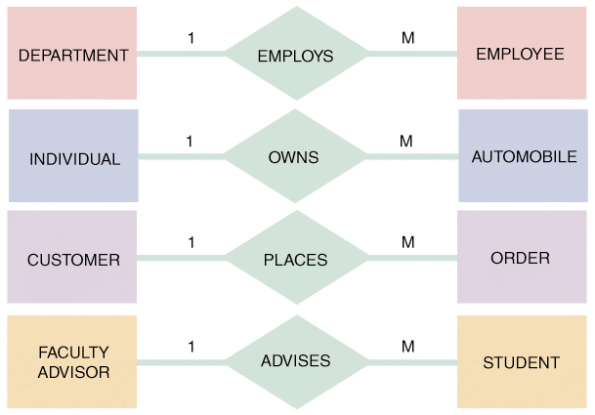
Entity-Relationship Diagrams (3 of 8)
One-to-many relationship (1:M): one occurrence of the first entity can relate to many instances of the second entity
Each instance of the second entity can associate with only one instance of the first entity
FIGURE 9-14 Examples of one-to-many (1:M) relationships.

Slide 19
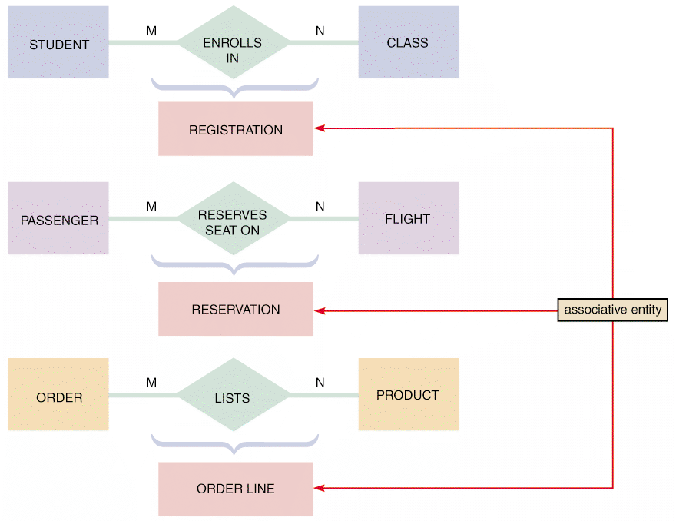
Entity-Relationship Diagrams (4 of 8)
Many-to-many relationship (M:N): one instance of the first entity can relate to many instances of the second entity, and vice versa
FIGURE 9-15 Examples of many-to-many (M:N) relationships. Notice that the event or transaction that links the two entities is an associative entity with its own set of attributes and characteristics.

Slide 20
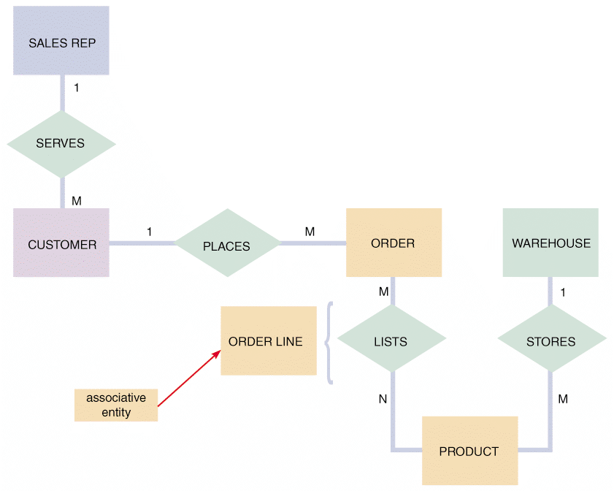
Entity-Relationship Diagrams (5 of 8)
FIGURE 9-16 An entity-relationship diagram for SALES REP, CUSTOMER, ORDER, PRODUCT, and WAREHOUSE. Notice that the ORDER and PRODUCT entities are joined by an associative entity named ORDER LINE.

Slide 21
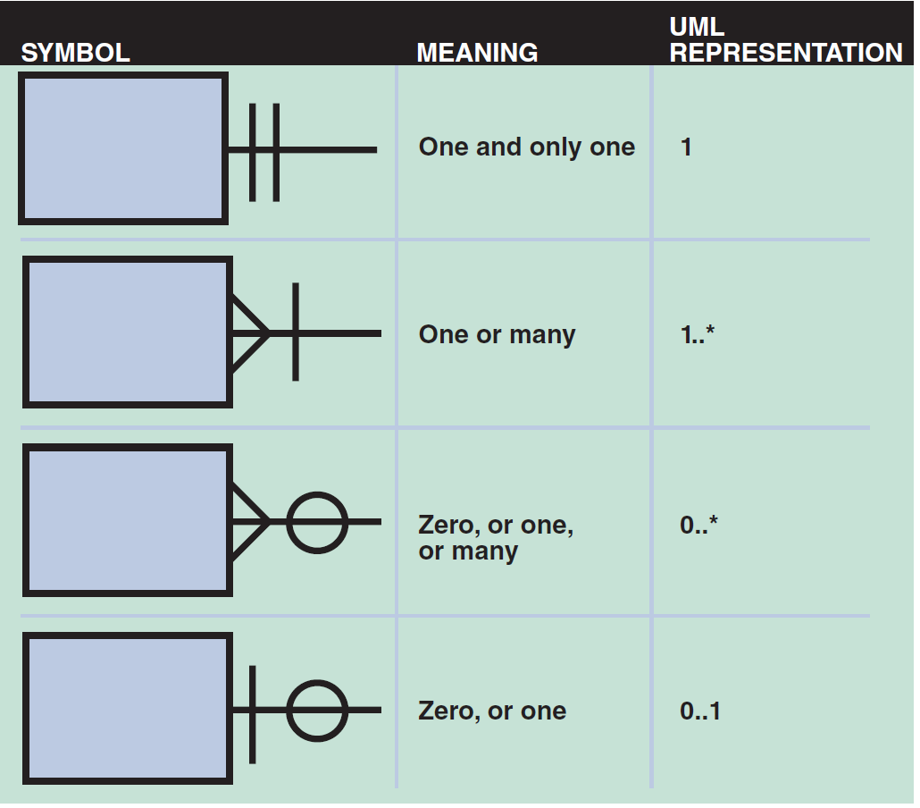
Entity-Relationship Diagrams (6 of 8)
Cardinality
Describes numeric relationship between two entities
Shows how instances of one entity relate to instances of another entity
Crow’s foot notation indicates various possibilities using circles, bars, and symbols
FIGURE 9-17 Crow’s foot notation is a common method of indicating cardinality. The four examples show how you can use various symbols to describe the relationships between entities.

Slide 22
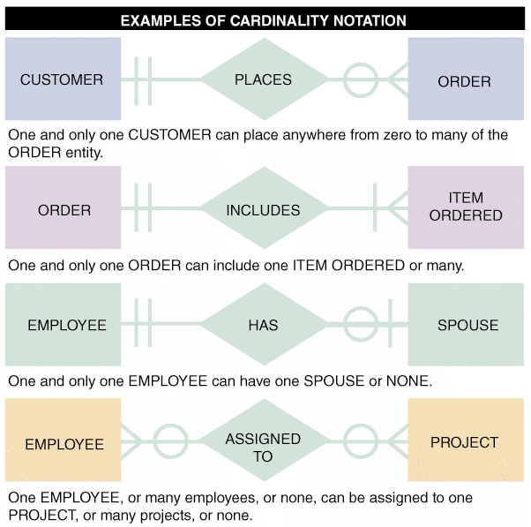
Entity-Relationship Diagrams (7 of 8)
FIGURE 9-18 In the first example of cardinality notation, one and only one CUSTOMER can place anywhere from zero to many of the ORDER entity. In the second example, one and only one ORDER can include one ITEM ORDERED or many. In the third example, one and only one EMPLOYEE can have one SPOUSE or none. In the fourth example, one EMPLOYEE, or many employees, or none, can be assigned to one PROJECT, or many projects, or none.

Slide 23
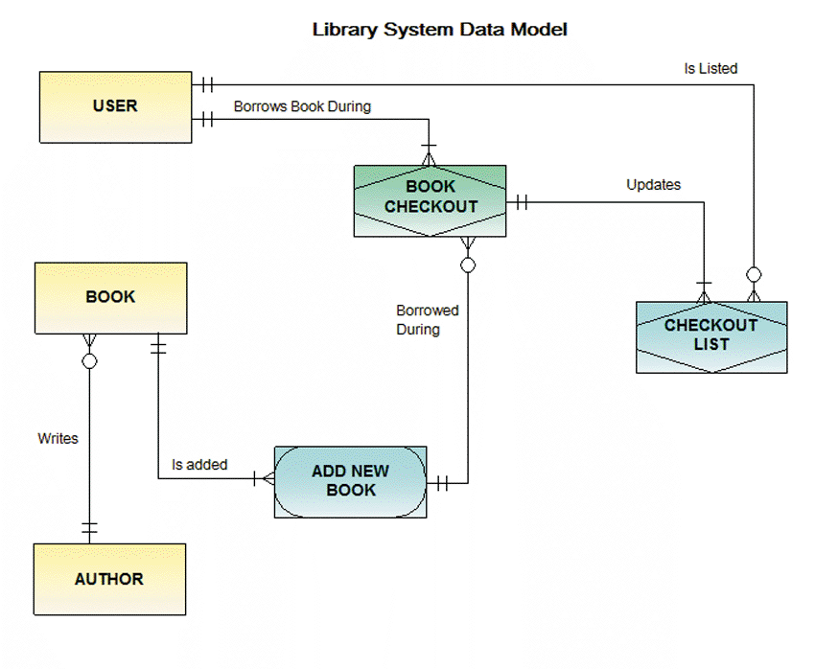
Entity-Relationship Diagrams (8 of 8)
FIGURE 9-19 An ERD for a library system drawn with Visible Analyst. Notice that crow’s foot notation has been used and relationships are described in both directions.

Slide 24
Data Normalization (1 of 9)
Normalization: creating table designs by assigning specific fields or attributes to each table in the database
Table design: specifies fields
Identifies the primary key in a particular table or file
Normalization stages
Unnormalized design
First normal form
Second normal form
Third normal form

Slide 25
Data Normalization (2 of 9)
Standard notation format
Used to show a table’s structure, fields, and primary key
The primary key field(s) is underlined
NAME (FIELD 1, FIELD 2, FIELD 3)
Recognition of repeating group fields is important
Repeating group: set of one or more fields that can occur any number of times in a single record
Each occurrence would possess different values

Slide 26
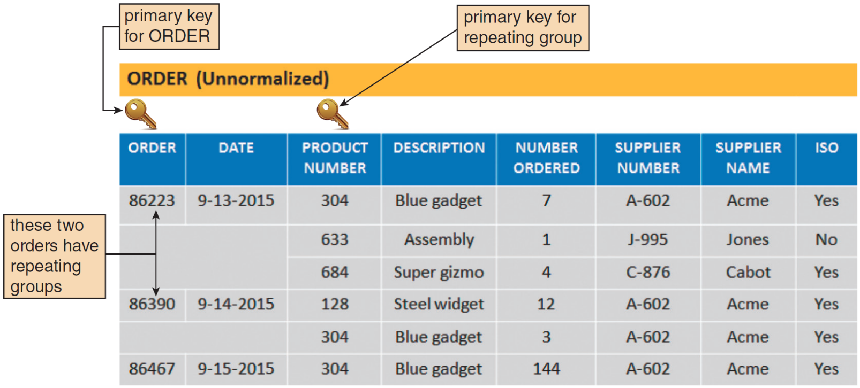
Data Normalization (3 of 9)
FIGURE 9-20 In the ORDER table design, two orders have repeating groups that contain several products. ORDER is the primary key for the ORDER table, and PRODUCT NUMBER serves as a primary key for the repeating group. Because it contains repeating groups, the ORDER table is unnormalized.

Slide 27
Data Normalization (4 of 9)
First Normal Form (1NF)
Does not contain a repeating group
Converting an unnormalized design to 1NF requires expansion of the table’s primary key to include the primary key of the repeating group

Slide 28
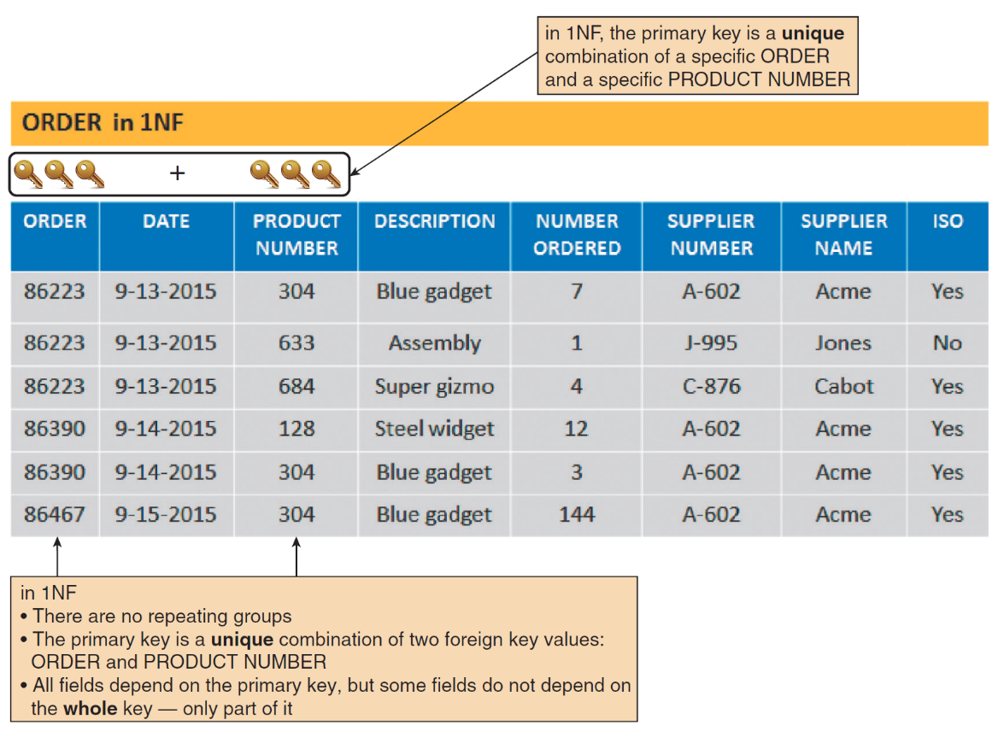
Data Normalization (5 of 9)
FIGURE 9-21 The ORDER table as it appears in 1NF. The repeating groups have been eliminated. Notice that the repeating group for order 86223 has become three separate records, and the repeating group for order 86390 has become two separate records. The 1NF primary key is a combination of ORDER and PRODUCT NUMBER, which uniquely identifies each record.

Slide 29
Data Normalization (6 of 9)
Second Normal Form (2NF)
Examples of functional dependence
Field A is functionally dependent on Field B if the value of Field A depends on Field B
A table design is in 2NF if it is in 1NF and all fields not part of the primary key are functionally dependent on the entire primary key

Slide 30
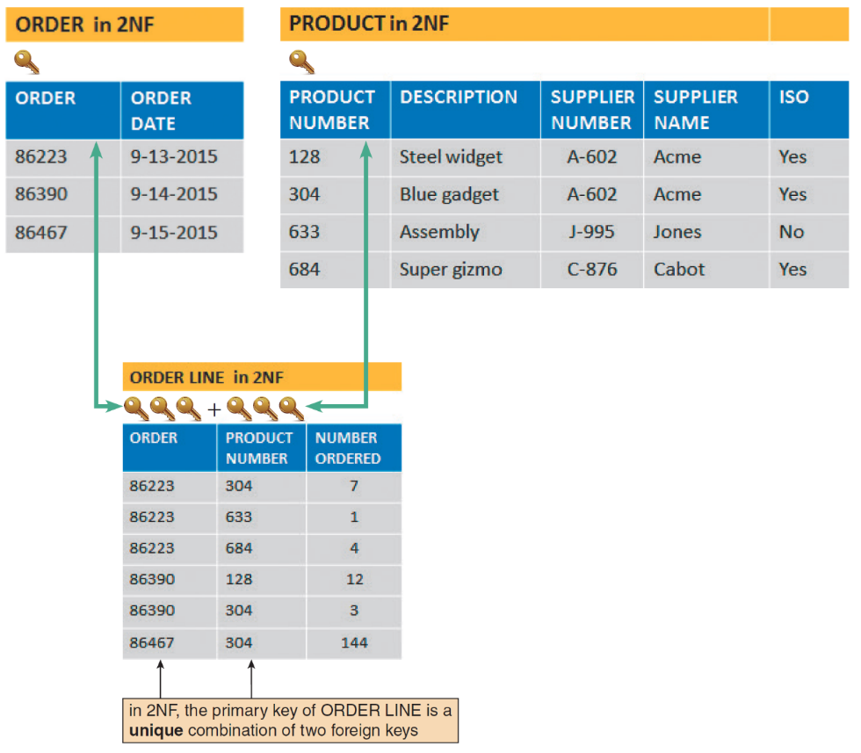
Data Normalization (7 of 9)
FIGURE 9-22 ORDER, PRODUCT, and ORDER LINE tables in 2NF. All fields are functionally dependent on the primary key.

Slide 31
Data Normalization (8 of 9)
Third Normal Form (3NF)
Design is in 3NF if every nonkey field depends on the key, the whole key, and nothing but the key
Avoids redundancy and data integrity problems that still can exist in 2NF designs

Slide 32
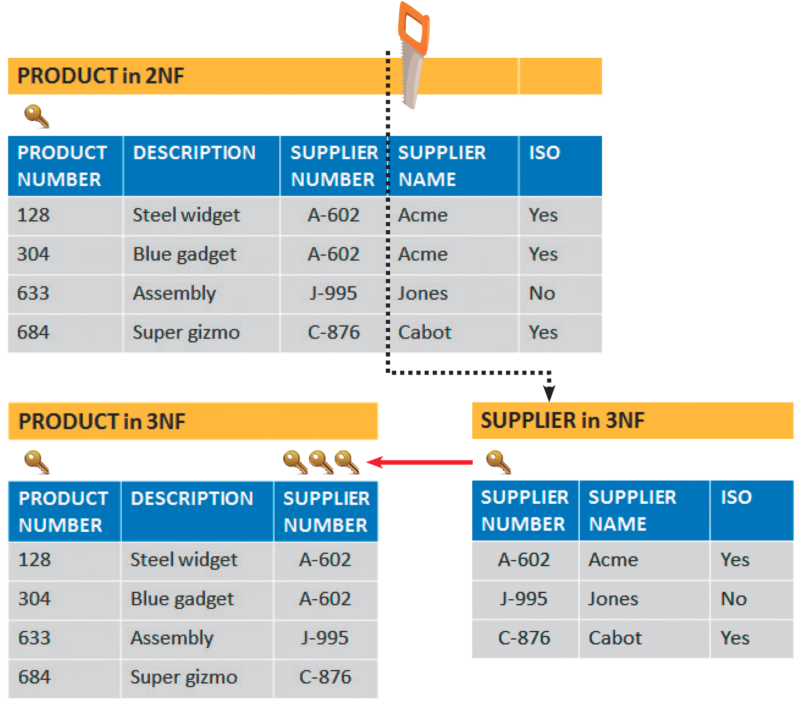
Data Normalization (9 of 9)
FIGURE 9-23 When the PRODUCT table is transformed from 2NF to 3F, the result is two separate tables:
PRODUCT and SUPPLIER. Note that in 3NF, all fields depend on the key, the whole key, and nothing but the key!

Slide 33
Two Real-World Examples
A good way to learn about normalization is to apply the rules to a representative situation
Refer to the text for two scenarios
School
Technical service company

Slide 34
Codes (1 of 4)
Overview of codes
Shorter than the data they represent
Save storage space and costs
Decrease data entry time and transmission time
Reveal or conceal information
Reduce data input errors
Easier to remember

Slide 35
Codes (2 of 4)
Types of codes
Sequence codes: numbers or letters assigned in a specific order
Block sequence codes: use blocks of numbers for different classifications
Alphabetic codes: use letters to distinguish one item from another
Category codes: identify a group of related items
Abbreviation codes: alphabetic abbreviations
Mnemonic codes: specific combination of letters that are easy to remember

Slide 36
Codes (3 of 4)
Significant digit codes: distinguish items by using a series of subgroups of digits
Derivation codes: combine data from different item attributes, or characteristics
Cipher codes: use a keyword to encode a number
Action codes: indicate what action is to be taken with an associated item

Slide 37
Codes (4 of 4)
Designing codes
Keep codes concise and consistent
Allow for expansion
Keep codes stable and make them unique
Use sortable codes and a simple structure
Avoid confusion and make codes meaningful
Use a code for a single purpose

Slide 38
Data Storage and Access (1 of 7)
Tools and techniques
Data warehouse
An integrated collection of data that can include seemingly unrelated information, no matter where it is stored in the company
Data mart
Designed to serve needs of a specific department

Slide 39
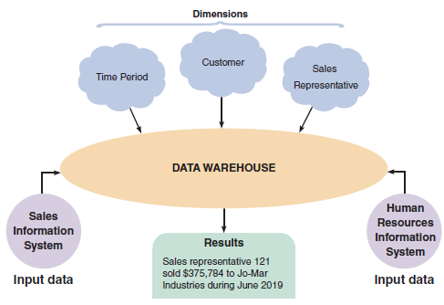
Data Storage and Access (2 of 7)
FIGURE 9-37 A data warehouse stores data from several systems. By selecting data dimensions, a user can retrieve specific information without having to know how or where the data is stored.

Slide 40
Data Storage and Access (3 of 7)
Data mining
Looks for meaningful data patterns and relationships
Suggested goals for data mining
Increase the number of pages viewed per session and referred customers
Reduce clicks to close
Increase checkouts per visit and average profit per checkout

Slide 41
Data Storage and Access (4 of 7)
Logical versus physical storage
Logical storage: data that a user can view, understand, and access, regardless of how or where that information actually is organized or stored
Physical storage: strictly hardware related
Involves the process of reading and writing binary data to physical media

Slide 42
Data Storage and Access (5 of 7)
Data coding
EBCDIC (Extended Binary Coded Decimal Interchange Code)
Mainframe computers and high-capacity servers
ASCII (American Standard Code for Information Interchange)
Used on most personal computers
Binary storage format
Represents numbers as actual binary values
Unicode: uses two bytes per character

Slide 43
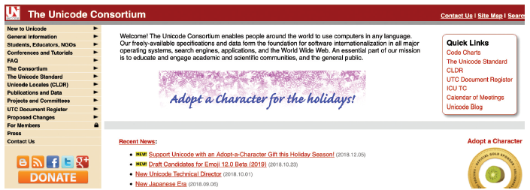
Data Storage and Access (6 of 7)
FIGURE 9-38 Unicode is an international coding format that represents characters as integers, using 16 bits per character. The Unicode Consortium maintains standards and support for Unicode.

Slide 44
Data Storage and Access (7 of 7)
Storing dates
International Organization for Standardization (ISO) requires a format of four digits for the year, two for the month, and two for the day (YYYYMMDD)
Absolute date: total number of days from some specific base date

Slide 45
Data Control
Well-designed DBMS
Must provide built-in control and security
Forms of data protection
Limited access to files and databases
User ID and passwords
Permissions and encryption
Backup copies of databases must be retained for a specified period of time
Recovery procedures can be used to restore

Slide 46
Summary (1 of 3)
A database consists of linked tables that form an overall data structure
DBMS enable users to add, update, manage, access, and analyze data in a database
DBMS designs are more powerful and flexible than traditional file-oriented systems
Components include interfaces for users, database administrators, and related systems

Slide 47
Summary (2 of 3)
Key fields include primary keys, candidate keys, foreign keys, and secondary keys
An entity-relationship diagram (ERD) is a graphic representation of all system entities and the relationships among them
Normalization is a process for avoiding problems in data design
A code is a set of letters or numbers used to represent data in a system

Slide 48
Summary (3 of 3)
Logical storage is information seen through a user’s eyes, regardless of how or where that information actually is organized or stored
File and database control measures include limiting access to the data, data encryption, backup/recovery procedures, audit-trail files, and internal audit fields

